Slide 1

QUSETION 4
Some scientists say that language is an instinct that we were born with,
not an art that people learn at school.How do you think of it?
Member：余汉泉 杨晨 张嘉诚 李瑾德 李祥逸

Slide 2

In this century, the most famous argument that language is like an instinct comes from Noam Chomskys, the linguist who first unmasked the intricacy of the system and perhaps the person most responsible for the modern revolution in language and cognitive science. In the 1950s the social scienceswere dominated by behaviorism the school of thought popularized by John Watsonand B.F.Skinner.Mental terms like “know” and “think” were branded as unscientific; “mind” and “innate” were dirty words. Behavior was explained by a few laws ofstimulus-response learningthat could be studied with rats pressing bars and dogs salivating over tones.But Chomsky called attention to two fundamental facts about language.First,virtually every sentence that a person utters or understands is a brand-new combination of words, appearing for the first time in the history of the universe.Therefore a language cannot be a repertoire of responses; the brain must contain a recipe or program that can build an unlimited set of sentences out of a finite list of words. That program may be called a mental grammar(not to be confused with pedagogical or stylistic “grammars”, which are just guides to the etiquette of written prose).

Slide 3

The second fundamental fact is that children develop these complex grammars rapidly and without formal instruction and grow up to give consistent interpretations to novel sentence constructions that they have never before encountered. Therefore, he argued, children must innately be equipped with a plan common to the grammars of all languages, a Universal Grammar, that tells them how to distill the syntactic patterns out of the speech of their parents.

Slide 4
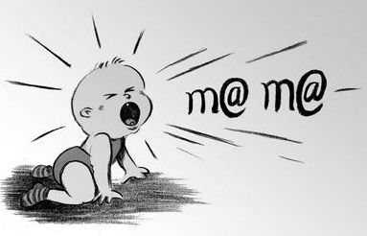
Language is everyone's innate instinct of self-study, and the younger the age, the stronger the instinct. Whether from the thinking of linguistic giant Chomsky or the actual combat of super artificial intelligence, it has been repeatedly confirmed that each young child's language talent far exceeds any theoretical system of linguists.

Slide 5
The advance of children's language intelligence development
Compared with other physiological and psychological functions and intelligence, it is significantly ahead of development and maturity. At the average age of 3, normal children can initially skillfully use their mother tongue, understand others' narration, express their requirements, describe things, and get endless fun from the stories told by their mother. In short, he can listen and speak freely, and he will not make subjective and deliberate efforts to listen and speak at all. Although his knowledge is "very poor", his experience is "extremely scarce", his cognitive level is "extremely childish", and his vocabulary is also very few, however, with regard to his own experience, knowledge and cognitive level, he is at ease with witty words. Think about it. At this time, the development of conjoined lattice and movement of young children is very preliminary. For example, tying shoes or four operations above 20 are a hundred times simpler than language, but it is very difficult for 3-year-old children. The advanced development of language intelligence forms a strong contrast with this.

Slide 6
THANK YOU!

